Slide 1

Curated Health
at your Fingertips
29 April 2025

Slide 2
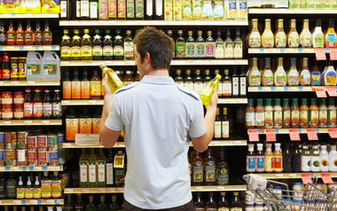
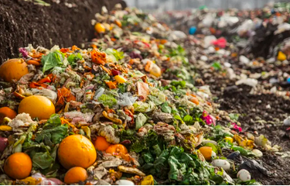
Problem
Almost 40 percent of the US food supply goes to landfills.
70 percent of our food supply is “ultra-processed”.
Notes:
Conflicting nutritional ideals and increasingly processed food products make it difficult to make good choices when grocery shopping.

Slide 3
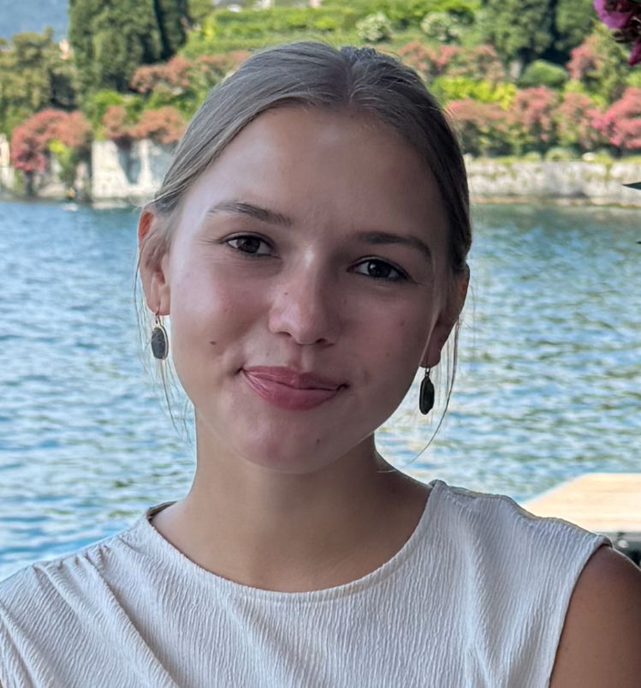


Meet the Team
Milana Serkin - CEO
Leadership & Computer Science
B.S Computer Science &
M.S. Bioinformatics
Beth Vaught - CTO
Data Science & Agricultural Economics
B.S. Crop and Soil Science &
M.S. Bioinformatics
Ansh Tina - CFO
Computer Science & Logistics
B.S. Biology &
M.S. Bioinformatics
mserkin@charlotte.edu
evaught@charlotte.edu
atina@charlotte.edu

Slide 4
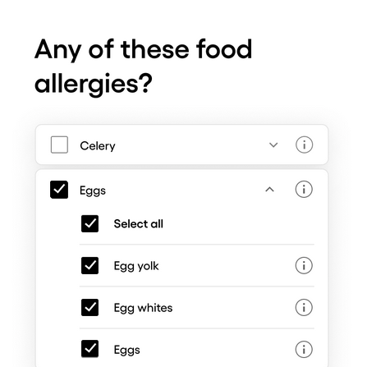
Solution
Grocery store products are connected to nutritional categories through a database
Scan products and receive recommendations
Build a virtual kitchen
Utilize recipes and expiration trackers

Slide 5
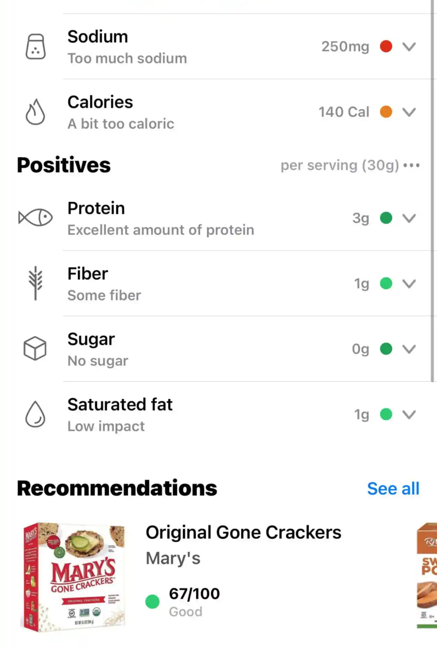
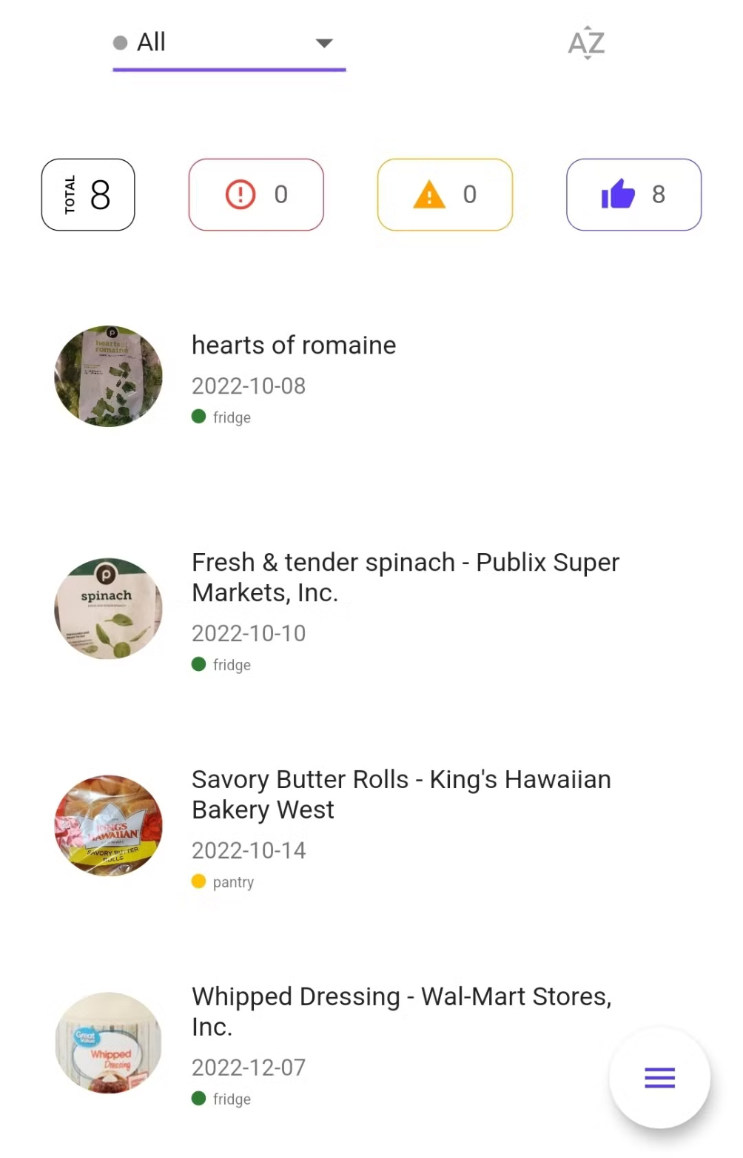
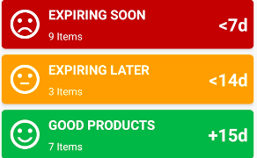
Graphical User Interface

Slide 6
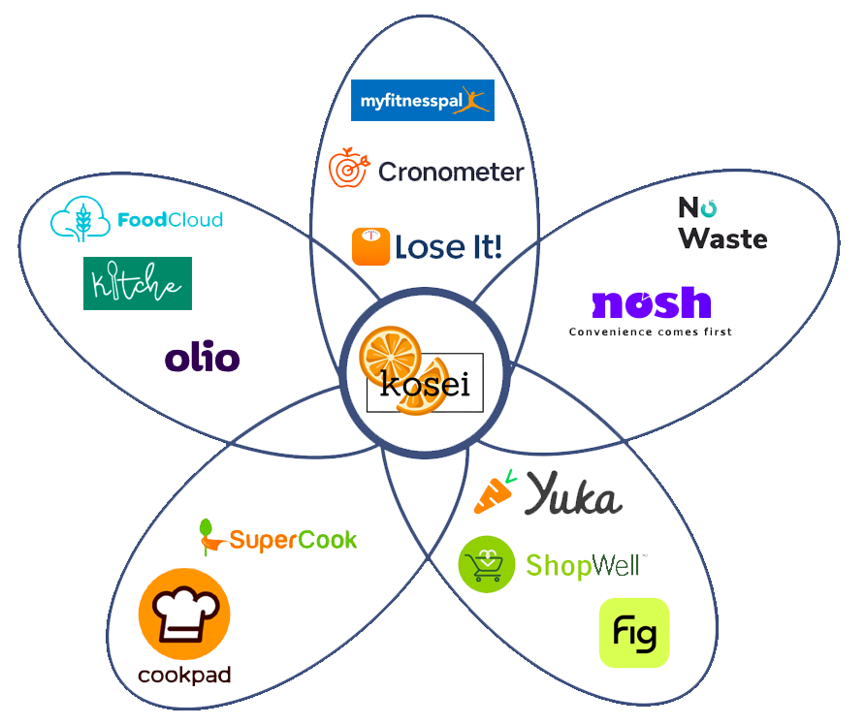
Digital
App
Competitive Market Overview
Diet Tracking
Food Waste
Pantry Tracking
Petal Chart Analysis
Recipes
Grocery Scanning

Slide 7
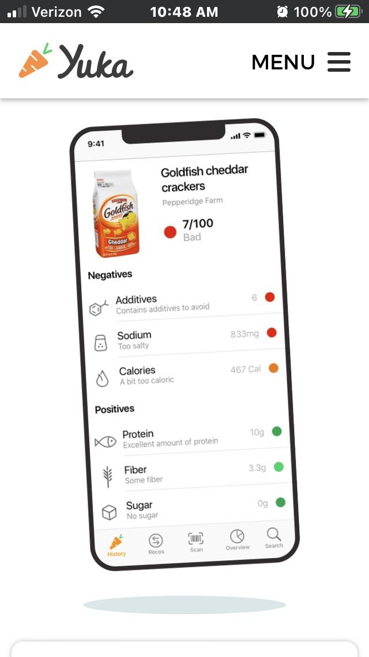
Competitor
Spotlight
Strengths
Efficient nutritional analysis
No advertisements
Non-biased funding
Weaknesses
Only contains popular products
No pantry feature
Shared Market: Grocery Scanning

Slide 8
How our app is different
Unique Value Proposition
Empower clients to do three things:
Make healthier choices
Reduce food waste
Simplify your grocery shopping
Competitive Advantage
Educated shopping experience
Our complete database
Cataloging your kitchen pantry

Slide 9
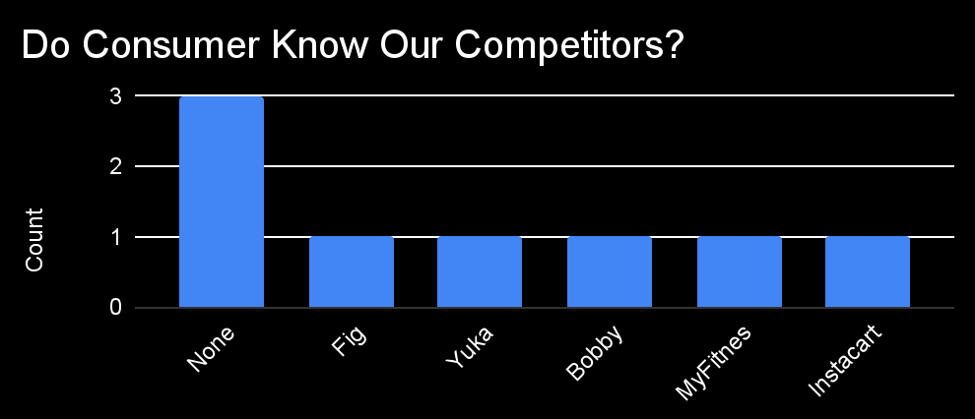
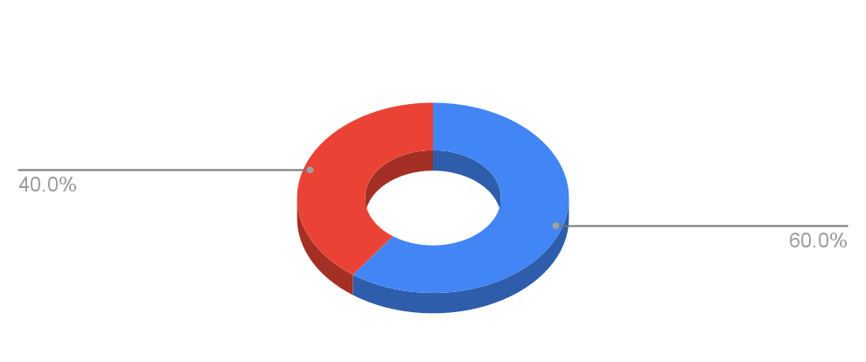
Customer
Discovery
Through virtual polling and data analysis, the solution can be tailored to our target customers.

Slide 10
Customer
Financial Ecosystem
Partner
Grocery Stores
Premium app features
$4.99/ month
Advertising
Data
Advertising
Brands
$
Data
Food Databases
$
Target Customers
$
Mobile app development
Web
hosting
Health interested
Environmentally compassionate
Family focused
$
Employee
Amazon

Slide 11
Market Analysis
Total Addressable Market:
$816.3 Billion “Nutrition Market”
Serviceable Addressable Market:
$396.2 Billion “Nutritional Education Market”
Serviceable Obtainable Market:
$149.7 Billion “Digital Food App Market”

Slide 12
Our Intellectual Property and Business Structure
Secret Algorithm Functionality
Nutritional and Pantry User Profiling
Efficient Database Navigation
C Corporation - Available for purchase
Trade Secret - Private algorithm
Personalized Product Recommendations

Slide 13
Personalized Health Meets Convenience:
Why Instacart Wants Our App
Alert customers to buy groceries
Reduce purchase friction
Improved competitive advantage
Increased future earnings

Slide 14
Project Timeline
Business Plan
Technical Development
Marketing
Q1 JAN—MAR
Q2 APR—JUN
Q3 JUL—SEPT
Finalize business model
Build algorithm
Run advertising campaigns
Establish Target Customer
Consult target customers
Build user friendly app experience
Develop marketing ideals
Connect with databases
Build advertising partnerships

Slide 15
Financial Timeline
Q1 JAN—MAR
Q2 APR—JUN
Q3 JUL—SEPT
$1,075,000
$55,000
$170,000
Polling and Brand Development
- $25,000
Six Employees
- $800,000
Database Partnership
- $250,000
AWS Hosting Costs
- $30,000
Quality Assurance
- $15,000
App Store Costs
- $10,000
Social Media Advertisements
- $130,000
Endorsements
- $40,000

Slide 16
Budget
$1,300,000
Investment in exchange for 15% of our company and a seat on our board
PLAN
CONNECT
BUILD
Establish company guidelines, goal, and model.
Attain resources and employees.
Create product and market to target audience.

